Slide 1
CS209: Computer Science II

Slide 2
Unit 3 Module 6:
Optimization
Introducing Optimization
Features
Type Inference
Registers
Coding for Efficiency

Slide 3
Optimization
The high priority of structured software development and the low priority of program efficiency is reflected, first and foremost, in the choice of programming language and interface frameworks.
Sometimes it is necessary to compromise on the advanced principles of software development in order to make software packages faster and smaller.
We note the trend of ever more powerful computers to keep up with the ever bigger software packages .

Slide 4
Optimization
structured software development
program efficiency

Slide 5
Optimization
We can still be efficiency-minded and meet the demands.
We look at ways to identify and isolate the most critical part of a program and concentrate the optimization effort on that particular part.
Also, look at programming constructs are costly and which are cheap, in relation to execution time
We discuss how to make a sensible balance between these considerations.

Slide 6
C++ Features
As you learn more about C++11, you will be surprised by the scope of the changes. For example auto declarations, range-based for loops, lambda expressions, and rvalue references change the face of C++, to say nothing of the new concurrency features.
And then there are the idiomatic changes. typedefs are out, nullptr and alias declarations are in. Enums should now be scoped. Smart pointers are now preferable to built-in ones. Moving objects is normally better than copying them.

Slide 7
C++ Features
We (CS people) look to create software that’s correct, efficient, maintainable, and portable.
We also will discuss how to make effective use of some of the new capabilities of 11 and 14.
Good reading - Scott Meyers’ Effective Modern C++

Slide 8
Type inference
• auto variables must be initialized, are generally immune to type mismatches that can lead to portability or efficiency problems, can ease the process of refactoring, and typically require less typing than variables with explicitly specified types.
The key is to know how to guide auto to the right answer

Slide 9
Type inference
The advantages of auto extend beyond the avoidance of uninitialized variables, verbose variable declarations, and the ability to directly hold closures. One is the ability to avoid problems related to “type shortcuts.” Here’s something you’ve probably seen—possibly even written:
std::vector<int> v;
…
unsigned sz = v.size();

Slide 10
Type inference
std::vector<int> v;
…
unsigned sz = v.size();
The official return type of v.size() is std::vector<int>::size_type, but few developers are aware of that.
std::vector<int>::size_type is specified to be an unsigned integral type, so a lot of programmers figure that unsigned is good enough and write code such as the above. This can have some interesting consequences.

Slide 11
Type inference
std::vector<int> v;
…
unsigned sz = v.size();
On 32-bit Windows, for example, both unsigned and std::vector<int>::size_type are the same size, but on 64-bit Windows, unsigned is 32 bits, while std::vector<int>::size_type is 64 bits. This means that code that works under 32-bit Windows may behave incorrectly under 64-bit Windows, and when porting ☹

Slide 12
Type inference
auto sz = v.size();
// sz's type is std::vector<int>::size_type
And so what can we do?
Using auto ensures we can porting our application from 32 to 64 bits without worrying about something that’s frankly a waste of our time.

Slide 13
Portability and Usability
The .NET framework and the Java virtual machine are frameworks that typically take much more resources than the programs they are running. Such frameworks are frequent sources of resource problems and compatibility problems and they waste a lot of time both during installation of the framework itself, during installation of the program that runs under the framework, during start of the program, and while the program is running.
The main reason why such runtime frameworks are used at all is for the sake of cross-platform portability.

Slide 14
Compatibility
All software should be tested on different platforms, different screen resolutions, different system color settings and different user access rights. Software should use standard API calls rather than self-styled hacks and direct hardware access.
Available protocols and standardized file formats should be used. Web systems should be tested in different browsers, different platforms, different screen resolutions, etc. Accessibility guidelines should be obeyed.

Slide 15
Security
The vulnerability of software with network access to virus attacks and other abuse is extremely costly to many users. Firewalls, virus scanners and other protection means are among the most frequent causes of compatibility problems and system crash. Furthermore, it is not uncommon for virus scanners to consume more time than anything else on a computer.
Security software that is part of the operating system is often more reliable than third party security software.

Slide 16
Back to…
THE OPTIMIZATION DISCUSSION

Slide 17
Register storage
A limited number of variables can be stored in registers instead of main memory. A register is a small piece of memory inside the CPU used for temporary storage.
Variables that are stored in registers are accessed very fast.
All optimizing compilers will automatically choose the most often used variables in a function for register storage. The same register can be used for multiple variables as long as their uses (live ranges) do not overlap.…

Slide 18
Register storage
The number of registers is very limited. There are approximately six integer registers available for general purposes in 32-bit operating systems and fourteen integer registers in 64-bit systems.
Floating point variables use a different kind of register. There are eight floating point registers available in 32-bit operating systems and sixteen in 64-bit operating systems. Some compilers have difficulties making floating point register variables in 32-bit mode.

Slide 19
64 better?
A software developer may choose to make memory-hungry software in two versions. A 32-bit version for the sake of compatibility with existing systems and a 64-bit version for best performance.
With 64-bit: Function parameters are transferred in registers rather than on the stack. This makes function calls more efficient.
The size of the integer registers is extended to 64 bits.

Slide 20
64 worse?
Pointers, references, and stack entries use 64 bits rather than 32 bits. This makes data caching less efficient.
Some instructions are one byte longer in 64 bit mode than in 32 bit mode.
Some 64-bit compilers are inferior to their 32-bit counterparts.

Slide 21
Cache and caching
What is it?
Cache (“Cash”) is to store data locally in order to speed up subsequent retrievals. And, it also refers to the reserved areas of memory in every computer that are used to speed up instruction execution, data retrieval and data updating.

Slide 22
Variable Storage
Before we hit variable storage, let’s review functions (again?).

Slide 23

Function efficiency notes
Choose leaf: A function that calls other functions is called a frame function, while a function that doesn't call any other function is called a leaf function. Leaf functions are more efficient than frame functions

Slide 24
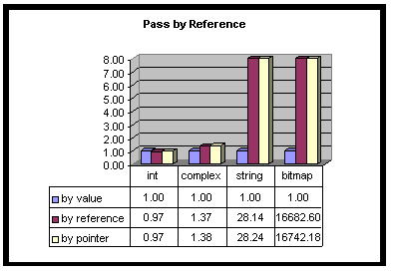
Relative performance
http://www.tantalon.com/pete/cppopt/asyougo.htm

Slide 25
Function efficiency notes
Function parameters are transferred by value in most cases. This means that the value of the parameter is copied to a local variable. This is efficient for simple types such as int, float, double, bool, enum as well as pointers and references.
Arrays are always transferred as pointers unless they are wrapped into a class or structure.

Slide 26
Function efficiency notes
If the parameter has a composite type such as a structure (like vector) or class (like string) then transferring is most efficient if:
the object is so small that it fits into a single register
the object has no copy constructor and no destructor
the object has no virtual member
the object does not use runtime type identification (RTTI)
If any of these conditions is not met then it is usually faster to transfer a pointer or reference to the object. If the object is large then it obviously takes time to copy the entire object.

Slide 27
Function libraries
Some applications spend most of their execution time on executing library functions. Time-consuming library functions often belong to one of these categories:
File input/output
Graphics and sound processing
Memory and string manipulation
Mathematical functions
Encryption, decryption, data compression

Slide 28
Function libraries
Most compilers include standard libraries for many of these purposes. Unfortunately, the standard libraries are not always fully optimized ☹.
May be possible to improve the performance significantly simply by using a different function library

Slide 29
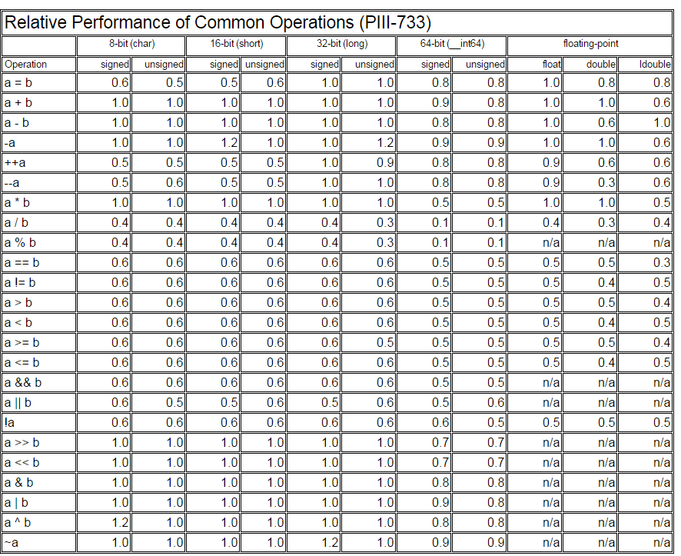
Relative performance

Slide 30
Relative performance

Slide 31
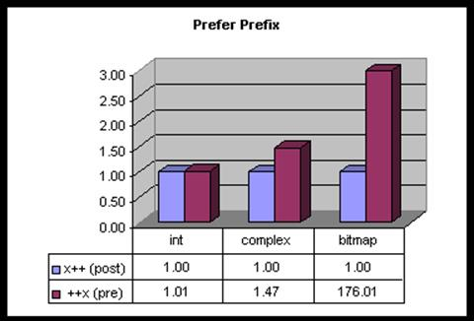
Relative performance
The prefix operator is almost 50% faster for complex objects.

Slide 32
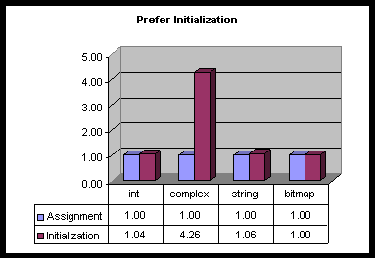
Relative performance
Combine with postponing your declaration until you can do an initialization.

Slide 33
Relative performance
Static variables in functions, used wisely and sparingly, can reduce the overhead of transferring the variable as function parameter
float SomeFunction (int x)
{
static float list[] = {1.1, 0.3, -2.0, 4.4, 2.5};
return list[x];
}

Slide 34
Security
The most serious problem with the C++ language relates to security. Standard C++ implementations have no checking for array bounds violations and invalid pointers.
This is a frequent source of errors in C++ programs and also a possible point of attack for hackers. It is necessary to adhere to certain programming principles in order to prevent such errors in programs where security matters.

Slide 35
Variable Storage
Different kinds of variable storage.
What is the relative efficiency of different C++ language elements?
Can help us, the programmer, when choosing the most efficient alternatives.

Slide 36
Stack and Heap
Stack
very fast access
don't have to explicitly de-allocate variables
space is managed efficiently by CPU, memory will not become fragmented
local variables only
limit on stack size (OS-dependent)
variables cannot be resized
Heap
variables can be accessed globally
no limit on memory size
(relatively) slower access
no guaranteed efficient use of space, memory may become
fragmented
we must manage memory (in charge of allocating and freeing variables) variables can be resized

Slide 37
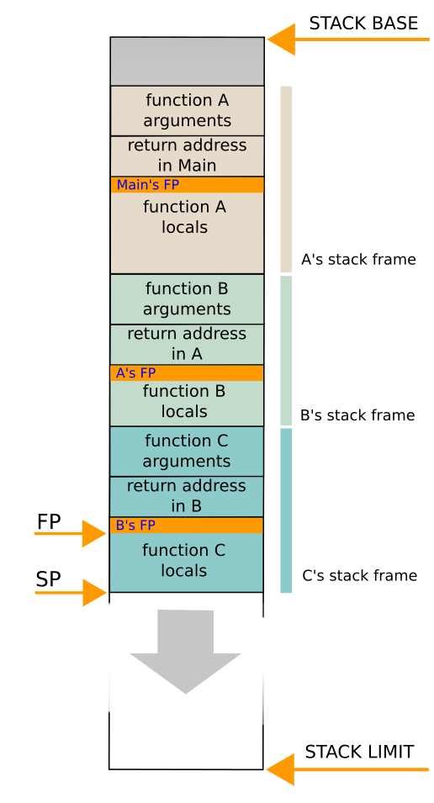
The stack and functions
Every time a function is called, it allocates the required amount of space on the stack for all these purposes. This memory space is freed when the function returns. The next time a function is called, it can use the same space for the parameters of the new function.
The stack is the most efficient memory space to store data because the same range of memory addresses is reused again and again.
FP – frame pointers
SP – stack pointer

Slide 38
Variable Storage
The stack is the most efficient memory space to store data because the same range of memory addresses is reused again and again.
If there are no big arrays, then it is almost certain that this part of the memory is mirrored in the level-1 data cache, where it is accessed quite fast.
Variables… try to declare local whenever possible.

Slide 39
Variable Storage
Integer operations are fast in most cases, regardless of the size. However, it is inefficient to use an integer size that is larger than the largest available register size.
The compiler will always select the most efficient integer size if you declare an int, without specifying the size.
Integers of smaller sizes (char, short int) are only slightly less efficient..

Slide 40
Variable Storage
Generally it is the case that there is no difference in speed between using signed and unsigned integers .
Integer operations are generally very fast. Simple integer operations such as addition, subtraction, comparison, bit operations and shift operations take only one clock cycle on most microprocessors.
The pre-increment operator ++i and the post-increment operator i++ are as fast as additions.

Slide 41
Variable Storage
Generally it is the case that there is no difference in speed between double and float.
Modern microprocessors in the x86 family have two different types of floating point registers and correspondingly two different types of floating point instructions.
Use double precision without worrying too much about the costs if it is good for the application. Use single precision if you have big arrays to get as much data as possible into the data cache

Slide 42
Variable Storage
The operands of the Boolean operators && , if the first operand of && is false, then the second operand is not evaluated at all. Likewise, if the first operand of || is true, then the second operand is not evaluated
If one operand is more predictable than the other, then put the most predictable operand first.
If one operand is faster to calculate than the other then put the operand that is calculated the fastest first.

Slide 43
Variable Storage
Pointers and references are equally efficient because they are in fact doing the same thing.
References are useful for copy constructors and overloaded operators.
Accessing a variable or object through a pointer or reference may be just as fast as accessing it directly.

Slide 44
Variable Storage
A smart pointer is an object that behaves like a pointer.
Smart pointers are used only for objects stored in dynamically allocated memory, using new.
The purpose of using smart pointers is to make sure the object is deleted properly and the memory released when the object is no longer used.

Slide 45
Variable Storage
Char[] is faster than string
String is a data structure, the compiler has to do branch and bound techniques to maintain it.
What’s that?
Enumerating all solutions is too slow for most problems.
Branch and bound (B & B) starts the same as enumerating, but it cuts out a lot of the enumeration whenever possible.
B & B is the starting point for all solution techniques for integer programming.
If we display the call stack, we can compare the memory foot print of a char[] vs String. If you are storing password or want to keep password more secure certainly do not use string because we can view your plain text in the dump.

Slide 46
Stings are immutable
Say what?
string myStr = “Holy cow”;
myStr = myStr + “ batman”;
The result is myStr holds “Holy cow batman”
So the string is changeable!!!
Not really. Because it is immutable, a new string object is created.
Then, it changes the reference (address) to point to the new string – that’s now myStr!
Variable Storage

Slide 47
Dynamic memory allocation
The cost of dynamic memory allocation is negligible when the number of allocations is limited. Dynamic memory allocation can therefore be advantageous when a program has one or a few arrays of variable size. The alternative solution of making the arrays very big to cover the worst case situation is a waste of cache space.
Dynamic memory allocation also tends to make the code more complicated and error-prone.
Memory leaks – allocating something that’s been deleted.

Slide 48
Efficiency notes regarding Classes
Class data members (properties)
Recall the data members of a class or structure are stored consecutively in the order in which they are declared whenever an instance of the class or structure is created.
There is no performance penalty for organizing data into classes or structures.
Accessing a data member of a class or structure object takes no more time than accessing a simple variable.

Slide 49
Efficiency notes regarding Classes
class S2
{
public:
int a[100]; // 400 bytes.
// first byte at 0, last byte at 399
int b; // 4 bytes.
// first byte at 400, last byte at 403
int ReadB() {return b;}
};
If the offset relative to the beginning of the structure or class is 128 bytes or more then the offset has to be expressed as a 32-bit number (the instruction set has nothing between 8 bit and 32 bit offsets).

Slide 50
Efficiency notes regarding Classes
class S2
{
public:
int b; // 4 bytes.
// first byte at 0, last byte at 3
int a[100]; // 400 bytes.
// first byte at 4, last byte at 403
int ReadB() {return b;}
};
This makes the code more compact so that the code cache is used more efficiently.

Slide 51
Efficiency notes regarding Structs
Rule: big arrays and other big objects come last in a structure or class declaration and the most often used data members come first.
If it is not possible to contain all data members within the first 128 bytes then put the most often used members in the first 128 bytes.

Slide 52
Efficiency notes regarding Classes
Class member functions (methods)
Each time a new object of a class is declared or created it will generate a new instance of the data members. But each member function has only one instance. The function code is not copied because the same code can be applied to all instances of the class.
Calling a member function is as fast as calling a simple function with a pointer or reference to a structure.

Slide 53
Efficiency notes regarding Classes
class S3
{
public:
int a;
int b;
int Sum1() {return a + b;}
};
int Sum2(S3 * p) {return p->a + p->b;}
int Sum3(S3 & r) {return r.a + r.b;}
The three functions Sum1, Sum2 and Sum3 are doing exactly the same thing and they are equally efficient. If you look at the code generated by the compiler, you will notice that some compilers will make exactly identical code for the three functions. Sum1 has an implicit 'this' pointer which does the same thing as p and r in Sum2 and Sum3.

Slide 54
Efficiency notes regarding Classes
Rule: make member functions faster by making them static if they don't need any non-static access.
A static member function cannot access any non-static data members or non-static member functions. A static member function is faster than a non-static member function because it doesn't need the this pointer.

Slide 55
Efficiency notes regarding Classes
Rule: turn RTTI off and use alternative implementations.
Runtime type identification (RTTI). Runtime type identification adds extra information to all class objects and is not efficient. If the compiler has an option for RTTI then turn it off and use alternative implementations.

Slide 56
Dynamic memory allocation
It is often more efficient to allocate one big block of memory for all the objects (memory pooling) than to allocate a small block for each object.
It is recommended to wrap the allocated memory into a container class. The container class must have a destructor to make sure everything that is allocated is also de-allocated. This is the best way to prevent memory leaks and other common programming errors associated with dynamic memory allocation
A little-known alternative to using new and delete is to allocate variable-size arrays with alloca.

Slide 57
Container classes
Whenever dynamic memory allocation is used, it is recommended to wrap the allocated memory into a container class. The container class must have a destructor to make sure everything that is allocated is also de-allocated.
This is the best way to prevent memory leaks and other common programming errors associated with dynamic memory allocation.
STL is designed for generality and flexibility, while execution speed, memory economy, cache efficiency and code size have got low priority. Especially the memory allocation is unnecessarily wasteful in the STL.

Slide 58
Container classes
Many containers use linked lists. A linked list is a convenient way of making the container expandable, but it is very inefficient. Linear arrays are faster than linked lists in most cases.
The so-called iterators that are used in STL for accessing container elements are cumbersome to use for many programmers and they are not necessary if you can use a linear list with a simple index. A good compiler can optimize away the extra overhead of the iterator in some cases, but not all..

Slide 59
Container classes
Contain one or multiple elements? If the container is to hold only one element then use a smart pointer
Is the size known at compile time? If the number of elements is known at compile time or a not-too-big upper limit can be set then the optimal solution is a fixed size array or container without dynamic memory allocation.
Is the size known before the first element is stored? If the total number of elements to store is known before the 1st element is stored then it is preferred to use a container that allows you to reserve the amount of memory needed in advance rather than allocating piecewise or re-allocating when a memory block turns out to be too small.

Slide 60
Container classes
Is a multidimentional structure needed? A matrix or multidimensional array should be stored in one contiguous memory block. Do not use one container for each row or column.
Are objects accessed in a FIFO manner? If objects are accessed on a First-In-First-Out (FIFO) basis then use a queue. It is more efficient to implement a queue as a circular buffer than as a linked list.
Are objects accessed in a FILO manner? If objects are accessed on a First-In-Last-Out (FILO) basis then use a linear array with a top-of-stack index.

Slide 61
Container classes
Are objects identified by a key? If the key values are confined to a narrow range then a simple array can be used. If the number of objects is high then the most efficient solution may be a binary tree or a hash map.
Do objects have a natural ordering? If you need to do searches of the kind: "what is the nearest element to x?" or "how many elements are there between x and y?" then you may use a sorted list or a binary tree.

Slide 62
Container classes
Is searching needed after all objects have been added? If search facilities are needed, but only after all objects have been stored in the container, then a linear array will be an efficient solution. Sort the array after all elements have been added and then use binary search for finding elements.
Is searching needed before all objects have been added? If search facilities are needed, and new objects can be added at any time, then the solution is more complicated. If the total # of elements is small then a sorted list is the most efficient solution because of its simplicity. But a sorted list can be very inefficient if the list is large because the insertion of a new element in the list causes all subsequent elements in the sequence to be moved. A binary tree or a hash map is needed in this case.

Slide 63
Container classes
Do objects have mixed types or sizes? It is possible to store objects of different types or strings of different lengths in the same memory pool. If the number and types of elements is known at compile time then there is no need to use a container or memory pool.
Alignment? Some applications require that data are aligned at round addresses. Especially the use of intrinsic vectors requires alignment to addresses divisible by 16. Alignment of data structures to addresses divisible by the cache line size (typically 64) can improve performance in some cases.
Multiple threads? Container classes are generally not thread safe if multiple threads can add, remove or modify objects simultaneously.

Slide 64
Container classes
Pointers to contained objects? It may not be safe to make a pointer to a contained object because the container may move the object in case memory re-allocation is needed. Objects inside containers should be identified by their index or key in the container rather than by pointers or references.
Can the container be recycled? There is a large cost to creating and deleting containers. If the program logic allows it, it may be more efficient to re-use a container than to delete it and create a new one.

Slide 65
Use lookup tables
Reading a value from a table of constants is very fast if the table is cached. Usually it takes only a few clock cycles to read from a table in the level-1 cache. We can take advantage of this fact by replacing a function call with a table lookup if the function has only a limited number of possible inputs.

Slide 66
Use lookup tables - example
int factorial (int n)
{ // n!
int i, f = 1;
for (i = 2; i <= n; i++)
f *= i;
return f;
}
This calculation requires n-1 multiplications, which can take quite a long time.

Slide 67
int factorial (int n)
{ // n! with table of factorials:
static const int factorialTable[13] = {1, 1, 2, 6, 24, 120, 720, 5040, 40320, 362880, 3628800, 39916800, 479001600};
if ((unsigned int)n < 13)
{ // Bounds checking
return factorialTable[n]; // Table lookup
}
else
{
return 0; // return 0 if out of range
}
}

Slide 68
Use lookup tables
static const int factorialTable[13]
The table should be declared const in order to enable constant propagation and other optimizations.
In most cases it is also recommended to declare the table static. This makes sure that the table is initialized when the program is loaded rather than each time the function is called.
You may declare the function inline.

Slide 69
Use lookup tables
Example:
int x = 14;
int y = 7 - x / 2;
return y * (28 / x + 2);
… constant propagation
int x = 14;
int y = 7 - 14 / 2;
return y * (28 / 14 + 2);

Slide 70
Code construction
Let’s take a look at some of the coding constructs (again?)

Slide 71
Loop Rules
Code Motion Out of Loops. Instead of performing a certain computation in each iteration of a loop, it is better to perform it only once, outside the loop.
Such as move an assignment to a variable or the calculation of a constant factor outside of the main loop.
Combining Tests. An efficient inner loop should contain as few tests as possible, and preferably only one. The programmer should therefore try to simulate some of the exit conditions of the loop by other exit conditions.
Sentinels are a common application of this rule: we place a sentinel at the boundary of a data structure to reduce the cost of testing whether our search has exhausted the structure.
Don’t reiterate through an entire data structure unnecessarily. Ask both questions in 1 loop.
for (int i = 0; i < ALL; ++i)
if (array[i] == “Rebublican") ++repVotes;
for (int i = 0; i < ALL; ++i)
if (array[i] == “Democratic") ++demVotes;

Slide 72
Loop Rules
Loop Unrolling. Unrolling a loop can remove the cost of modifying loop indices, and also help to avoid pipeline stalls, to reduce branches, and to increase instruction-level parallelism.
Unrolling a loop to sum an array of ten real numbers reduced the run time from 63.4 microseconds to 22.1 microseconds.
for (int i = 0; i < 400; ++i)
{
varA[i] = varB[i] + varC[i];
}
Unrolling as … does 200 instead of 400 compares …
for (inti= 0; i < 400; i += 2)
{
varA[i] = varB[i] + varC[i];
varA[i + 1] = varB[i + 1] + varC[i + 1];
}
Loop unrolling - Increases the number of instructions between branches
The compiler and the hardware get more opportunities now to find instruction-level parallelism.

Slide 73
Loop Rules
Transfer-Driven Loop Unrolling. If a large cost of an inner loop is devoted to trivial assignments, then those assignments can often be removed by repeating the code and changing the use of variables. Specifically, to remove the assignment i = j, the subsequent code must treat j as though it were i.
Unconditional Branch Removal. A fast loop should contain no unconditional branches. An unconditional branch at the end of a loop can be removed by ``rotating'' the loop to have a conditional branch at the bottom.
This operation is usually done by optimizing compilers. This technique is also applicable only in low-level languages.
Loop Fusion. If two nearby loops operate on the same set of elements, then combine their operational parts and use only one set of loop control operations.
To find the maximum and minimum elements in an array, we make only one iterative pass through an array.

Slide 74
Logic Rules
Exploit Algebraic Identities. If the evaluation of a logical expression is costly, replace it by an algebraically equivalent expression that is cheaper to evaluate.
Short-Circuiting Monotone Functions. If we wish to test whether some monotone non-decreasing function of several variables is over a certain threshold, then we need not evaluate any of the variables once the threshold has been reached.
A more sophisticated application of this rule exits from a loop as soon as the purpose of the loop has been accomplished.
A search loops that terminates once it finds the desired element.
Reordering Tests. Logical tests should be arranged such that inexpensive and often successful tests precede expensive and rarely successful tests.
Push an expensive test inside a cheaper test, such as testing the character types in a lexical analyzer

Slide 75
Logic Rules
Precompute Logical Functions. A logical function over a small finite domain can be replaced by a lookup in a table that represents the domain.
The Standard C++ library character classification functions can be implemented by table lookup.
Developing a fast interpreter for an emulator that has one table entry for each of the 4096 possible instructions.
Boolean Variable Elimination. We can remove boolean variables from a program by replacing the assignment to a boolean variable v by an if-else statement in which one branch represents the case that v is true and the other represents the case that v is false.
More complex applications of this rule remove boolean variables from data structures by keeping separate structures for the true and false records.

Slide 76
Procedure Rules
Collapsing Function Hierarchies. The run times of the elements of a set of functions that (non-recursively) call themselves can often be reduced by rewriting functions in line and binding the passed variables.
Dennis Ritchie increased the speed of a macro processor by a factor of four by writing procedures inline.
Exploit Common Cases. Functions should be organized to handle all cases correctly and common cases efficiently.
A storage allocator handles all node sizes correctly, but handles the most common node size particularly efficiently by caching them.
Co-routines. A multiple-pass algorithm can often be turned into a single-pass algorithm by use of co-routines.
An intermediate file that is written sequentially and then read sequentially can often be removed by linking together the two programs as co-routines; this increases space requirements but reduces costly input/output operations.

Slide 77
Procedure Rules
Transformations on Recursive Functions. The run time of recursive functions can often be reduced by applying the following transformations:
Rewrite recursion to iteration, as in the lists and binary search trees.
Convert the recursion to iteration by using an explicit program stack. (If a function contains only one recursive call to itself, then it is not necessary to store the return address on the stack.) If the final action of a function is to call itself recursively, replace that call by a branch to its first statement; this is usually known as removing tail recursion.
A branch can often be transformed into a loop.
Compilers often perform this optimization. It is often more efficient to solve small sub-problems by use of an auxiliary procedure, rather than by recurring down to problems of size zero or one.
Parallelism. A program should be structured to exploit as much of the parallelism as possible in the underlying hardware.

Slide 78
Expression Rules
Compile-Time Initialization. As many variables as possible should be initialized before program execution.
Exploit Algebraic Identities. If the evaluation of an expression is costly, replace it by an algebraically equivalent expression that is cheaper to evaluate.
Replace an expensive C++ remainder operator % in an inner loop with a cheaper if statement.
We can often multiply or divide by powers of two by shifting left or right. Replace an arbitrary division, such as a division by 10 with a shift by 4.

Slide 79
Expression Rules
Compile-Time Initialization. As many variables as possible should be initialized before program execution.
Exploit Algebraic Identities. If the evaluation of an expression is costly, replace it by an algebraically equivalent expression that is cheaper to evaluate.
Gain additional numeric accuracy in a data structure to replace 64-bit floating point numbers with faster 32-bit numbers.
Strength reduction on a loop that iterates through the elements of an array replaces a multiplication by an addition. Many compilers perform this optimization. This technique generalizes to a large class of incremental algorithms.

Slide 80
Expression Rules
Common Subexpression Elimination. If the same expression is evaluated twice with none of its variables altered between evaluations, then the second evaluation can be avoided by storing the result of the first and using that in place of the second.
Modern compilers are usually good at eliminating common subexpressions that do not contain function calls.
Pairing Computation. If two similar expressions are frequently evaluated together, then we should make a new procedure that evaluates them as a pair.
The maximum and the minimum elements of a vector can be found at about 1.5 times the cost of finding either one

Slide 81
Testing speed
Testing the speed of a program is an important part of the optimization job. You have to check if your modifications actually increase the speed or not.
Find a hot spot, and then isolate the hot spot and make measurements on this part of the code only.

Slide 82
The pitfalls of unit-testing
Testing the speed of a program is an important part of the optimization job. You have to check if your modifications actually increase the speed or not.
Find a hot spot, and then isolate the hot spot and make measurements on this part of the code only.

Slide 83
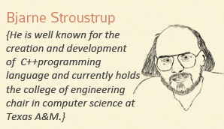
Is Will efficient – that’s the real question. I wonder how long it takes him to find his car in the parking lot?

Slide 84
References
Slide contributions include:
Scott Meyers, Effective Modern C++. Copyright © 2015 (O’Reilly) , 978-1-491-90399-5.
Andrew Koenig and Barbara E. Moo, Accelerated C++ Practical Programming by Example,
Addison-Wesley, 2000 ISBN 0-201-70353-X1.
Agner Fog. Optimizing software in C++ An optimization guide for Windows, Linux and Mac platforms Technical University of Denmark. Copyright © 2004 – 2015
Jon Bentley, Programming pearls (2nd ed.), ACM Press/Addison-Wesley Publishing Co., New York, NY, 1999

